Slide 1
HCI LAB 2
Paper prototype assignment

Slide 2
Prototype
An early model or representation of a product
Can be physical or digital
The goal – to learn, test and improve, not to deliver a finished product

Slide 3
LoFi vs HiFi
types of prototype: low-fidelity and high-fidelity
Lofi = fast, simple, conceptual
HiFi = detailed, realistic, close to final product

Slide 4
Paper prototype
Low-fidelity prototype
Hand-drawn sketches showing screens, layout and flows
Tools: paper, pens
Best used for
Early exploration of concepts and layouts
Testing navigation and flow
Getting client approval before investing in visuals
For projects with unclear or evolving requirements

Slide 5
Why paper prototype?
Fast and inexpensive
Easy to change or discard ideas
Great for group collaboration and brainstorming
Enables early usability testing

Slide 6
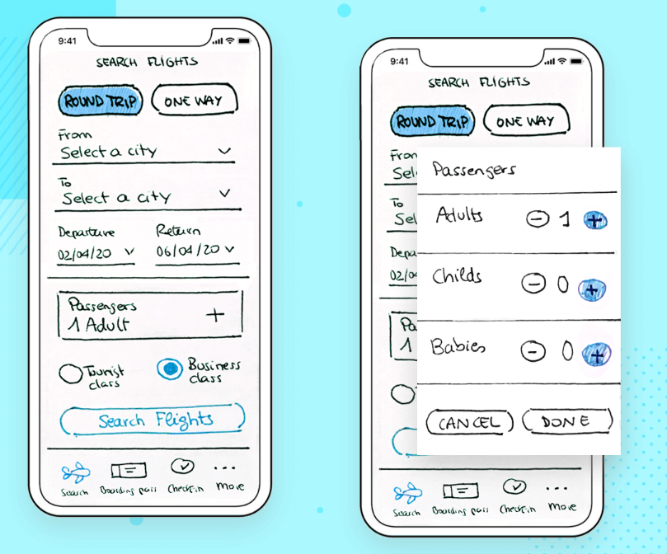

Slide 7
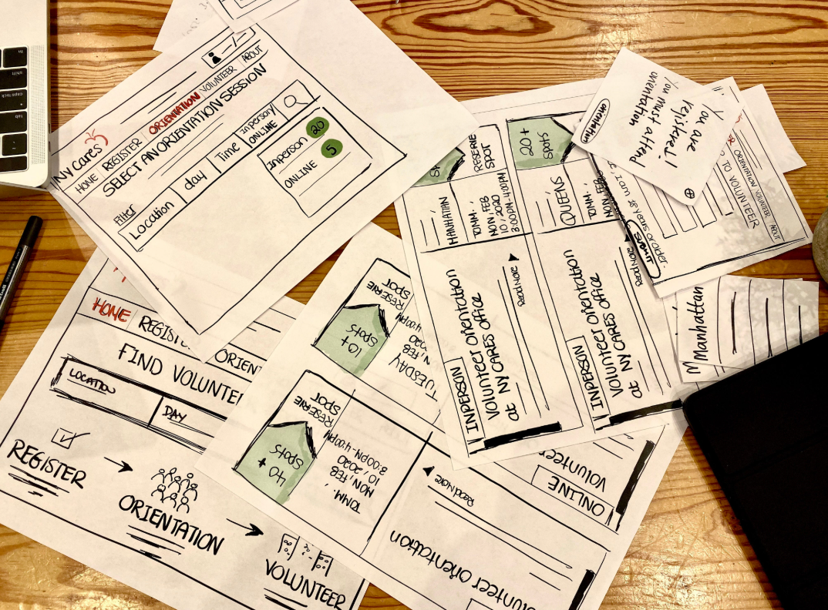

Slide 8
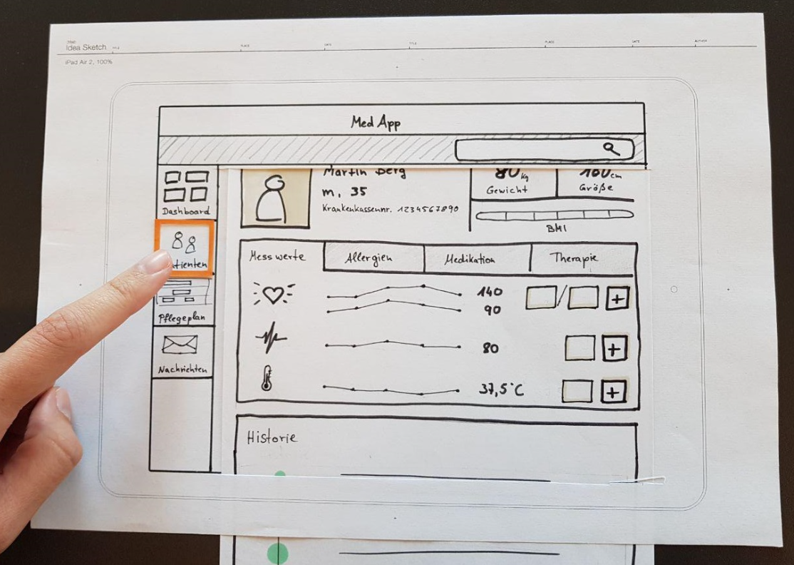

Slide 9
Assignment
Create a team – max 5 people (you can also work alone)
Choose one of the assignments from the document on Moodle – needs to be one of the assignments!
All client requirements must be met
Work on your paper prototype until the 4th lab
Upload pictures of your paper prototype to the Moodle or submit physically during labs
INCLUDE LIST OF TEAM MEMBERS

